Slide 1
MSc Data Analytics (Jan 23/Sept 23/Jan 24 intake)- Research Project MSc Cloud Computing – Research Project MSc Fintech, MSc Cybersecurity, MSc AI, MSc AI for Business – Practicum Part 2/ Internship Part 2 MSc Data Analytics (Sept 24 intake and onwards) – Research Practicum Part 2/ Internship Part 2
Module Overview

Slide 2
Module Overview
Module name: Research Project
Credit Rating: 25
Credit Level: 9
Contact Hours: Timetabled weekly sessions
E.g. 2-4 hours based on group size
Module Lecturer: Check Timetable for your group
MSc Data Analytics
(Jan 23/Sept 23/Jan 24 intakes only)
MSc Cloud Computing
Research in Computing
Research Project

Slide 3
Module Overview
Module name: Practicum Part 1 & 2 / Internship Part 1 & 2 Credit Rating: 5+ 25
Credit Level: 9
Contact Hours: Timetabled weekly sessions
Practicum/ Internship Part 2 - E.g. 2-4 hours based on group size
Module Lecturer: Check Timetable for your group supervisor
MSc AI MSc AI for Business
MSc Cybersecurity
MSc Fintech
Practicum Part 1/ Internship Part 1
Practicum Part 2/ Internship Part 2

Slide 4
Module Overview
Module name: Research Practicum Part 1 & 2 / Internship Part 1 & 2
Credit Rating: 5+ 25
Credit Level: 9
Contact Hours: Timetabled weekly sessions
Research Practicum/ Internship Part 2 - E.g. 2-4 hours based on group size
Module Lecturer: Check Timetable for your group supervisor
MSc Data Analytics
(Sept 24 onwards intakes only)
MSc Open Data Practice
Research Practicum Part 1/ Internship Part 1
Research Practicum Part 2/ Internship Part 2

Slide 5
Research Project - Module Learning Outcomes
On successful completion of this module, students will be able to:
LO1 Analyse, select and implement appropriate research methods and techniques
LO2 Research and critically analyse the state of the art of a problem domain
LO3 Propose, architect and implement an ICT solution related to the programme area
LO4 Evaluate the solution based on identified measures
LO5 Investigate potential future research / commercialisation possibilities
LO6 Present and defend the research findings through a viva, artefact/product demo and research paper style report

Slide 6
Practicum/Internship Part 1 & 2- Module Learning Outcomes
On successful completion of this module, students will be able to:
LO1. Propose a research question, project objectives and methodology.
LO2. Analyse, synthesise, and critically evaluate the state of the art.
LO3. Propose, architect, implement and evaluate an ICT solution related to the programme area.
LO4. Investigate potential future research and invention disclosures.
LO5. Present and defend the research findings through a viva, artefact/product demo, and report.
LO6. Understand the ethical issues that need to be addressed when conducting research.
LO7. Demonstrate initiative whilst working alone or part of a team, and appropriate communication and interpersonal skills.

Slide 7
Research Practicum/Internship Part 1 & 2- Module Learning Outcomes
On successful completion of this module, students will be able to:
LO1. Propose a research question, project objectives and methodology.
LO2. Analyse, synthesise, and critically evaluate the state of the art.
LO3. Propose, architect, implement and evaluate an ICT solution related to the programme area.
LO4. Investigate potential future research and invention disclosures.
LO5. Present and defend the research findings through a viva, artefact/product demo, and report.
LO6. Identify, assess, and resolve the ethical issues that need to be addressed when conducting research.
LO7. Demonstrate initiative whilst working alone or part of a team, and appropriate communication and interpersonal skills.

Slide 8
Objectives
To consolidate the knowledge and skills acquired in other modules by carrying out an interdisciplinary research project that combines both research and technical skills
To develop an in-depth understanding of some specific topics related to their chosen discipline,
To apply research methods and techniques and to develop a software/product/artefact.
To investigate, design, produce, evaluate and critically analyse an innovative ICT solution related to the course area
Research Project: The research work shall build upon the work conducted as part of Research in Computing module
Practicum/ Research Practicum: The research work shall build upon the work conducted as part of Practicum/Research Practicum Part 1
Internship: The research work shall build upon the tasks conducted in the company. A new research proposal is required

Slide 9
Research Project/ Internship/ Practicum - Requirements
Portfolio submission consisting of
Weekly activity reports required for MSc Cloud Computing, MSc Cybersecurity, MSc Fintech, MSc AI/AIBUS, MSc Data Analytics (Sept 24 intake onwards), MSc Open Data Practice
NOT REQUIRED for MSc Data Analytics (Jan 23/Sept 23/Jan 24 intake) doing Research Project
Research paper style report (up to 20 pages)
ICT Solution
Configuration manual
Presentation Video + Demo Video
Answers for the questions given by the two examiners
Videos
Oral Presentation (10 minutes): Learners are required to record a presentation of their research
Demo ( 5-10 minutes): A demonstration of ICT solution to be illustrated
Student must submit the video recordings
Submission deadline available on MSc project Moodle page
NOTE: The College reserves the right to request a live viva session to take place in the event where examiners feel that further clarification is required regarding a student submission.

Slide 10
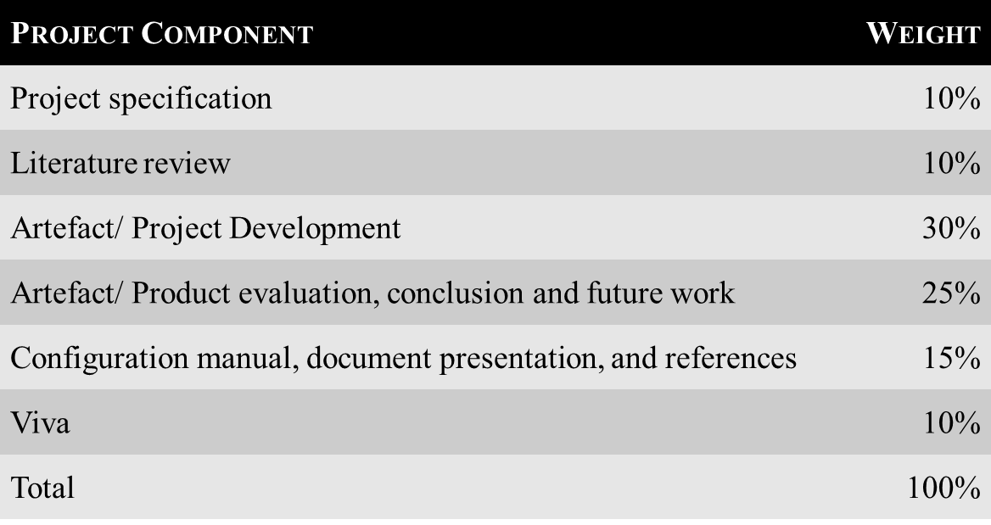
Marking Scheme – Research Project MSc Data Analytics (Jan 23/Sept 23/Jan 24 intake) doing Research Project

Slide 11
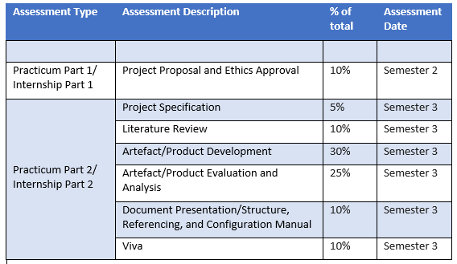
Marking Scheme – Practicum/ Internship MSc AI, MSc AI for Business, MSc Fintech, MSc Cybersecurity
Completed
Weekly activity reports : Students must provide in the supervision meetings a summary of weekly research activities performed on the project over the entire semester. These reports must be submitted on Moodle page, weekly

Slide 12
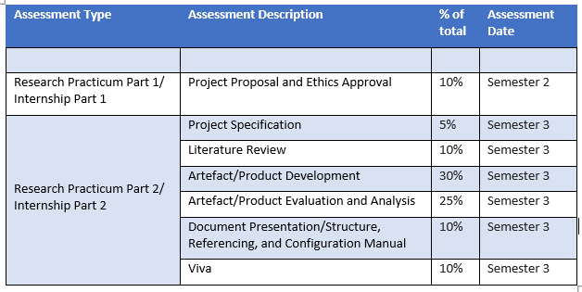
Marking Scheme – Research Practicum/ Internship MSc Data Analytics (Sept 24 intake and onwards) MSc Open Data Practice
Completed
Weekly activity reports : Students must provide in the supervision meetings a summary of weekly research activities performed on the project over the entire semester. These reports must be submitted on Moodle page, weekly.

Slide 13
Marking Scheme – Research Project MSc Cloud Computing ONLY
Assessment Description | % of total
Weekly progress monitoring | 12%
Project Final Submission | 88%
Weekly progress monitoring assessment: Students must provide a summary of weekly research activities performed on the project during the entire semester. These report must be submitted on Moodle page, weekly.

Slide 14
Marking Scheme – Research Project MSc Cloud Computing ONLY
Note: Weekly progress reports – 12%

Slide 15
Ethics Consideration
To be considered when your project falls into one scenario or two of them or all 3 of them
Scenario 1
Primary data – data collected by the investigator conducting the research/work (e.g. measurements, interviews, tests)
Human participants are involved in your study
Requirement specification stage
App Interface design feedback
Evaluation and Testing stage
Surveys and Interviews
Declaration of Ethics Consideration Form
Ethics Application Form

Slide 16
Ethics Consideration
Scenario 2
Secondary Dataset(s) is used in your study
Data is/was collected by someone
Data is taken from a web site(s)
Data is provided by a company
Declaration of Ethics Consideration Form

Slide 17
Ethics Consideration
Scenario 2
Secondary Dataset(s) is used in your study
Scenario 2 A
Scenario 2 B
PUBLIC Secondary Dataset(s) is used
A letter/email from the copyright holder is required to confirm potential use of data
OR, Citation and link to the web site where permission is granted
PRIVATE Secondary Dataset(s) is used
Permission to use the dataset MUST BE received from the owner
An approval letter/email from the owner must be attached to the form

Slide 18
Ethics Consideration
Scenario 3
Target System = any asset, device, infrastructure component, hosting environment, network, or application, that is intended to be used by the current researcher as the target system for testing their ICT solution artefact. This can include a penetration testing target or any system under test.
Target System(s) are involved in your study
Target systems planed to be used during testing
Real public systems are intended to be used
Target system was not created by the student
Declaration of Ethics Consideration Form
Letter/email evidence that permission/authorization has been granted to the student for using the system.
Rules of engagement evidence for penetration testing, vulnerability scans, or other ethical hacking engagement,.

Slide 19
REMEMBER!
It is students’ responsibility to ensure that they have the correct permissions/authorizations to use any data/ target system in a study.
Projects that make use of data or target systems that does not have authorization to be used, will not be graded for that portion of the study that makes use of such data.

Slide 20
How to Submit my Form(s) ?
The following information regarding Ethics is available on Project Moodle page
Declaration of Ethics Consideration Form
Ethical Review Application Form
An example of an Ethics Form submitted for a project
Forms submission links
Note: Provide all the required information into the Ethics Application Form (e.g. consent form, survey questions, interview questions,, details on how the collected data will be analysed, etc.)
Submission link: Available on MSc project Moodle page
If ethical approval was received in Research in Computing/ Practicum Part 1/ Research Practicum Part 1 and if there are no changes regarding ethical conditions, there is no need for resubmission of the form.

